Slide 1
Data Visualization
Week 3

Slide 2
Github and assignment housekeeping
Assignment tips on Canvas
Clean up Github folders
Your project should contain:
Some scripts
One . Rproj file
A datafile
ONE readme.md file that tells you how these things go together
All of your scripts should run from beginning to end with no errors
Your README file should only contain a log, not actual code. Put your code in your scripts. (See example here: https://github.com/VTQuantMethodsEEB/klangwig/blob/master/README_example.md)
You will need to do a new commit, and push to share any changes to your files with me. Each week you will need to “pull” to see my comments on your scripts. Then, commit and push to send me your assignment.
Please annotate your code
If you have a question about something, you can ask in your code annotation
#I would like to print the names of the species that are higher than the mean, but I’m not sure how to do that
I will (try) to help and push back the script to you with how to do this! (Hopefully…)

Slide 3
Preparation
Install package “ggplot2”
Install package “gridExtra”
Fun extras:
Install package “viridis”
Install package “ggforce”
Install package ”shiny” (maybe we want to do this as an extension?)
Install package “ggthemes”
This is really awesome – use themes based on plots from The Economist, STATA, Excel 2003, Fivethirtyeight, WSJ, etc.

Slide 4
Goals
Participants will learn to think broadly about the effective uses of visualization
(aka get your papers into top journals using compelling figures)
Understand previous research on visualization
Learn the ggplot2 package and some extensions

Slide 5
What makes figures compelling?

Slide 6
Some history on data visualization
There is a HUGE field dedicated to the perception of data (e.g. marketing, business, art)
Scientists rarely take these classes or know anything about it
There are a few exceptions that have “broken through” into our field

Slide 7
Cleveland & McGill 1984 Jour. Of the American Statistical Association.
They outline the problem – graphs are presented haphazardly
What’s in it? The paper describes a series of experimental studies to understand how basic visual primitives (e.g. color, length, size) compare in delivering quantitative information.
Why is it important? It presented a hierarchy for understanding data to best portray quantitative information.

Slide 8
Hierarchy (most to least accurate in perception of quantitative data)
Position along a common scale
Positions along non-aligned scales
Length, direction, angle
Area
Volume, curvature
Shading, color saturation

Slide 9
Examples of the elementary perceptual task
Saturation: not included because “expense” of color figs
Shading and hue: excluded from study because they do not have an unambiguous method for ordering from large to small
Notes:
Position along a common scale (bar chart, dot plots)
Positions along nonaligned, identical scales (small multiples)
Length, direction, angle (pie chart)
Area (treemap)
Volume, curvature (3-D bar charts, area charts)
Shading, color saturation (heat maps, choropleth maps)

Slide 10
Position-length experiment
What percent of the larger is the smaller?

Slide 11
Edward Tufte
Chartjunk: stuff that isn’t necessary to understand the graph

Slide 12
Edward Tufte
Data-rich visualizations:
every data point has value, but when observed more generally only trends and patterns can be observed
High data-ink ratio
John Snow’s map of cholera fatalities

Slide 13
Edward Tufte
Small multiples:
A series of similar graphs using the same scale or axes
Prevalence of fungal infections on bats at multiple sites

Slide 14
Edward Tufte
Direct labeling:
Put the text on the figure

Slide 15
Direct labeling

Slide 16
More Tufte info
https://www.edwardtufte.com/tufte/
Books: https://www.amazon.com/Edward-R.-Tufte/e/B000APET3Y

Slide 17
Principles of Information Design
Tell the truth
Get to the point
Pick the right tool for the job
Highlight what is important
Keep it simple

Slide 18
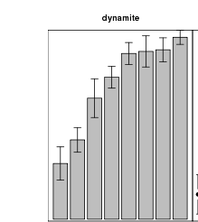
Dynamite plots: an unmitigated evil?

Slide 19
What is so bad about dynamite plots?
They have low data-ink ratios
They hide the raw data
The (can) assume symmetric confidence bounds

Slide 20
What is good about dynamite plots?
they are comfortingly familiar to most people
they anchor the data at zero (is this good?)
they provide more area for displaying colors or gray scales than plots that use a single point for each value which may make it easier to distinguish groups of treatments in the data

Slide 21
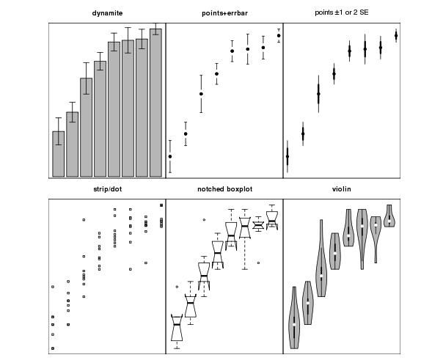
Alternatives
Notes:
A Notched Box Whisker is a graphic way to view data that can be very useful.
The box shows the interquartile range (IQR). The IQR is the 25 to 75
percentile also known as (aka) Q1 and Q3. The IQR is where the center 50% of your data points will fall (as a 5 foot 8 inch American male this is where I would plot).
The whiskers add 1.5 times the IQR to the 75 percentile (aka Q3) and subtract 1.5 times the IQR from the 25 percentile (aka Q1). The whiskers should include 99.3% of the data if from a normal distribution. So the 6 foot tall man from the example would be inside the whisker but my 6 foot 2 inch girlfriend would be at the top whisker or pass it.
The Line - Shows the median of the data
The Notch - displays the a confidence interval around the median which is normally based on the median +/- 1.57 x IQR/sqrt of n. According to Graphical Methods for Data Analysis (Chambers, 1983) although not a formal test the, if two boxes' notches do not overlap there is ‘strong evidence’ (95% confidence) their medians differ. Note Here are the pages from the book. Citation Chambers, John M., William S. Cleveland, Beat Kleiner, and Paul A. Tukey. "Comparing Data Distributions." In Graphical Methods for Data Analysis, 62. Belmont, California: Wadsworth International Group;, 1983. ISBN 0-87150-413-8 International ISBN 0-534-98052-X
------------------
A violin plot is a method of plotting numeric data. It is similar to box plot with a rotated kernel density plot on each side. The violin plot is similar to box plots, except that they also show the probability density of the data at different values (in the simplest case this could be a histogram).

Slide 22
Pies: only for eating
Pie charts are not great for displaying data
Compare the north and south – which is larger? How much larger?

Slide 23
Pies: only for eating
Pie charts aren’t great for displaying data

Slide 24
Pie chart caveats
Pies can be somewhat useful for clearly displaying things that sum to 1 (e.g. 100%), and useful for eyeballing ½, ¼ etc.
They can sometimes be helpful for providing descriptive detail that isn’t critical for understanding of a figure, but you want to provide a reader that cares (e.g. data rich figs, fig limits).
Notes:
Figure 1. (a,b) Geographical variation in bat colony size, community composition and Pseudogymnoascus destructans prevalence and infection intensity in Asia and North America. Maps show the study regions and study sites (stars) in China and the USA. The pie charts show the total colony size (pie size, on a log scale, range 20–5158) and community composition of bats at each site. The fraction of each species that were tested positive for P. destructans is shown by the hatched or darker portion of each pie slice. Boxplots show the infection intensity for each species at the same sites on a log scale (ng) (note different scales for Asia and North America). Pie charts and boxplots use the same colour scheme for species, which is indicated by the legend. (Online version in colour.)

Slide 25
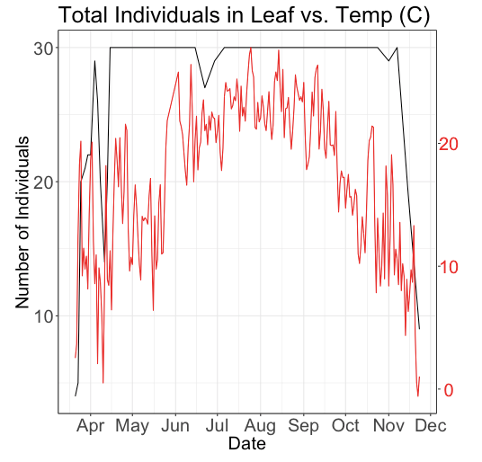
Dual axes graphs
Issues:
Scales can have a big impact on the viewer
They imply a causal relationship (very sloppy in time series)
They are often hideous

Slide 26
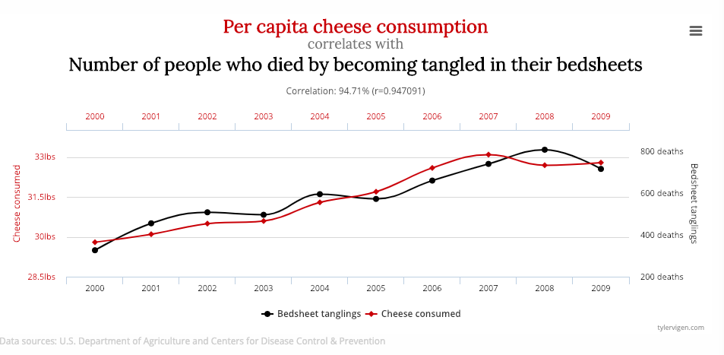
A nod to next week…(http://www.tylervigen.com/spurious-correlations)

Slide 27
Let the data speak vs storytelling
Scientists feel differently about the relative value of each of these
What do you see as the advantages or disadvantages of each?

Slide 28
The combination is critical
Nothing is more irritating to scientists than not being able to figure out what your data looks like. Only slightly less irritating is having to interpret your data because you didn’t do it for them.
YOUR job is to:
1) Tell your story.
- put the output of statistics on your graphs
- plot the important relationships
2) give the raw data to people so they can look at it themselves
- don’t just plot the statistical output – overlay the points!
- sometimes it isn’t practical to put all the raw data in a paper, but make tables, figs, etc. for online sources to show this to readers that want it

Slide 29
A few additional points of advice
Consider your audience.
Powerpoint vs print; novices vs field-specific, etc.
2) Don’t lie or censor data without good reason.
Use consistent scales that represent your data, and don’t magnify the effect
3) Create figures that are compelling and tell a narrative.

Slide 30
The graph shows the relationship between cort and noise in all three species and two life stages. Baseline cort levels for both adults and nestlings were negatively affected by noise (Left and Center Columns, respectively), while acute stress-induced cort levels in nestlings were positively affected by noise (Right Column). For each model, the effect of noise was consistent across species, irrespective of species-specific cort levels. The gray-shaded areas indicate the 85% CIs for each estimated effect.
Kleist 2018 PNAS

Slide 31
Dengue epidemiology in Pakistan in 2013. (A) The location of dengue cases throughout Pakistan and the number of cases per week by tehsil. Tehsils that reported at least 15 cases are shown on the map with corresponding color shown in the time series. The majority of cases were reported in Karachi (gray), Lahore (blue), and Mingora (orange). The dengue season in the entire country lasted 35 wk, with the first reported case in Karachi during week 18 (end of April). (B) The reported cases (red), temperature (blue), and model fit (black) for Karachi are shown. Using the case and temperature data, the human and vector population dynamics were modeled (Materials and Methods).
Wesolowski 2015 PNAS

Slide 32
Kilpatrick 2006 Proc. Roy. Soc.
Notes:
(a) Relative abundance of birds at two residential sites and three urban sites. For scientific names see AOU (2005). (b) Percent of avian feedings from each host species based on identification of Culex mosquito blood meals by PCR amplification of the cytochrome b gene followed by DNA sequencing. Sample size of mosquito feedings in parentheses. (c) Feeding indices of Culex mosquitoes and 95% CI. Positive values are preferences; negative values designate avoidance and are calculated as (K1/Pi). Columns with an asterisk are minimum avoidance estimates (see §2). All preferences, except hatched columns, are significantly different from 1 (two-tailed p!0.05; all robin preferences p!0.0001). (d) Amplification fraction (proportion of abundance!feeding preference!reservoir competence) of each species, a surrogate for the fraction of West Nile virus infectious mosquitoes resulting from feeding on that avian host.

Slide 36
ggplot2
Best website for help: http://ggplot2.tidyverse.org/reference/
aesthetic mappings: between variables in the data frame and aesthetics, or graphical attributes (x position, y position, size, colour ...)
first two show up as (e.g.) ggplot(my_data, aes(x=age,y=rootgrowth,colour=phosphate))
geoms:
simple: geom_point, geom_line:
SWITCH TO CONSOLE

